Slide 1
Song Generation (P3)
Tymoteusz Bieganski 266390

Slide 2
Main idea
Goal: Generate the next couple seconds for a given input song

Slide 3
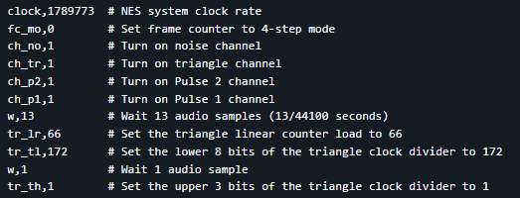
Results
Nintendo Entertainment System Music Database (NES-MDB)
Consists of 5278 songs from the soundtracks of 397 NES games
Each song can be turned into this format

Slide 4
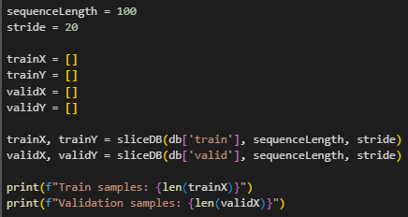

Results
Converting lists of words into lists of numbers

Slide 5
Results
Embedding(vocabSize → 256) # Converts token IDs into dense vectors
BiLSTM(256 → 512×2, 2 layers) # Bidirectional LSTM, 2 layers, hidden size 512 per direction
LayerNorm(1024) # Normalizes across the 1024 output features
Dropout(0.3) # Randomly zeroes 30% of features for regularization
Linear(1024 → vocabSize) # Maps features to output token scores (logits)
I trained for 10 epochs ( ~ 4 Hours)

Slide 6
Results (Final Part)
Start with an initial sequence
Predict the next token
Add it to the sequence
Use the updated sequence to predict the next one

Slide 7
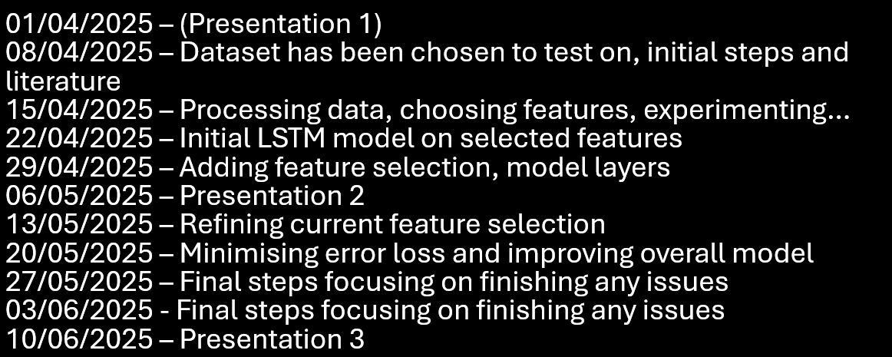
Postmortem
I believe that the project was successful, in accordance with the milestones set initially

Slide 8
Postmortem
Things learnt: - Working with LSTM Models
- Working with signal generation
Would I choose this approach again?
Yes – For a semester long project, LSTM model provides a good baseline
No – For a larger scaled project

Slide 9
Postmortem
Possible things to explore:
Different music genres
Giving larger initial sequence inputs
A better solution would involve the use of Transformers..
Zhou et al., “Informer: Beyond Efficient Transformer for Long Sequence Time-Series Forecasting,” AAAI 2021.
https://github.com/openai/jukebox/tree/master

